Slide 1
Pipe Bursting
By: xxx, xxx, and Mira

Slide 2
Assumptions
Constant wall temperature
1D flow
9 % volume expansion on freezing
Ice nucleation temp -5 C
Constant Mass Flow
Constant heat capacity

Slide 3
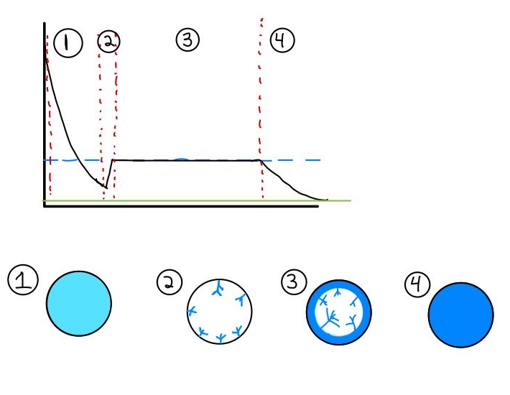
Stages of Pipe Freezing
Stage 1: Initial Cooling and Supercooling where water is cooled to below freezing point
Stage 2: Dendritic Ice formation happens when the water reaches the ice nucleation temperature
Stage 4: After 98% of the water becomes ice, the temperature drops to the temperature of environment
Stage 3: Annular ice formation happen once the water reaches phase change temperature
Temperature
Phase Change Temp
Environment Temp
Time
Notes:
Emily

Slide 4
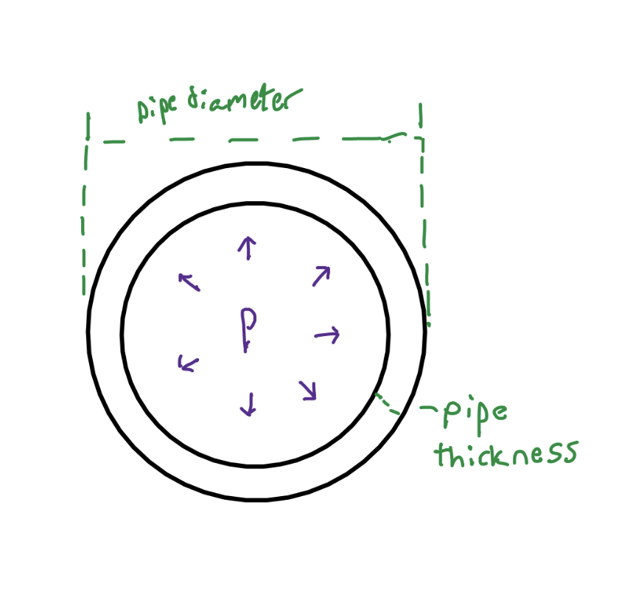
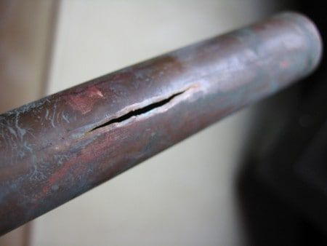
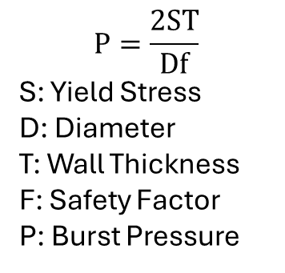
Failure Mechanism
Water expands when it freezes increasing pressure in the pipe
Pipe bursts when the hoop stress exceeds the yield strength of the material
Cracks form parallel to the length of the pipe
$$P=\frac{2ST}{Df}$$
S: Yield Stress
D: Diameter
T: Wall Thickness
F: Safety Factor
P: Burst Pressure
Notes:
Failture Mechanism

Slide 5
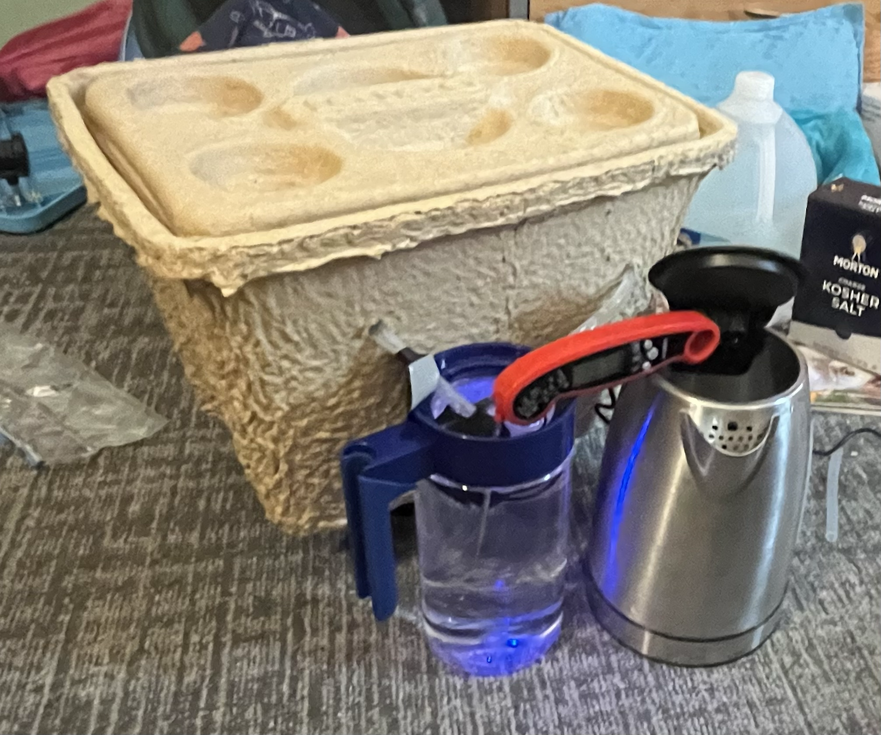
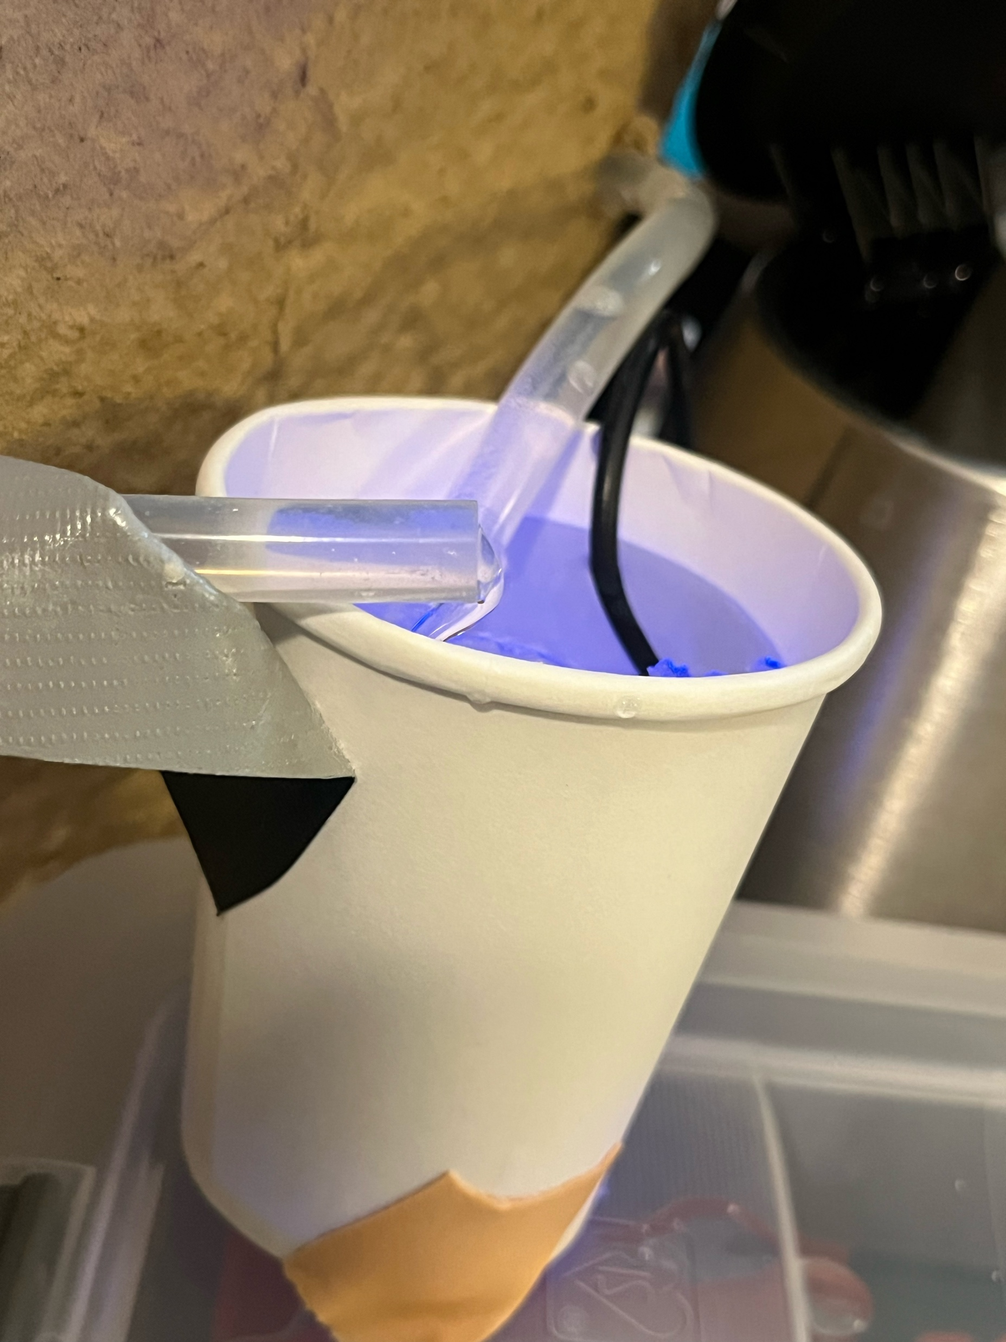
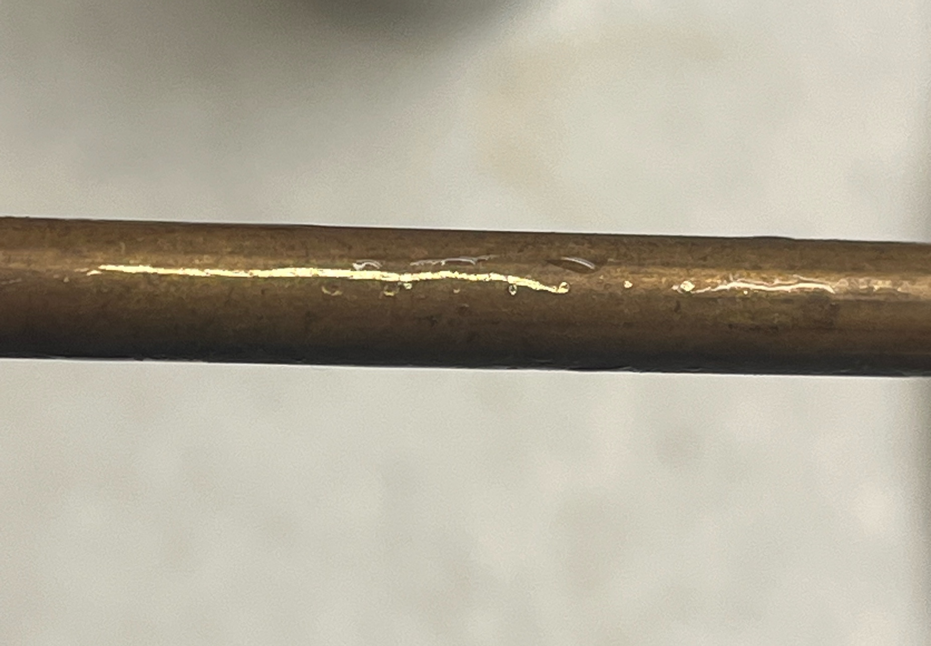
Physical Recreation
Passed pipe through cooler of ice and salt
Switched to smaller cup to drop temp faster
Small Cracks formed in frozen pipe segment with water sealed inside

Slide 6
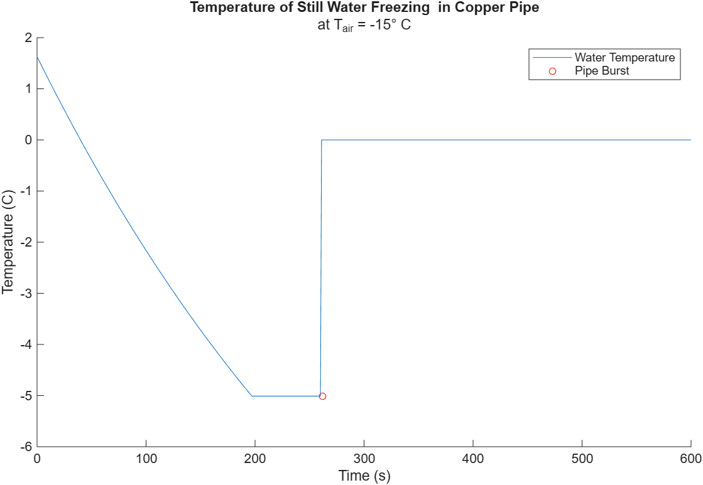
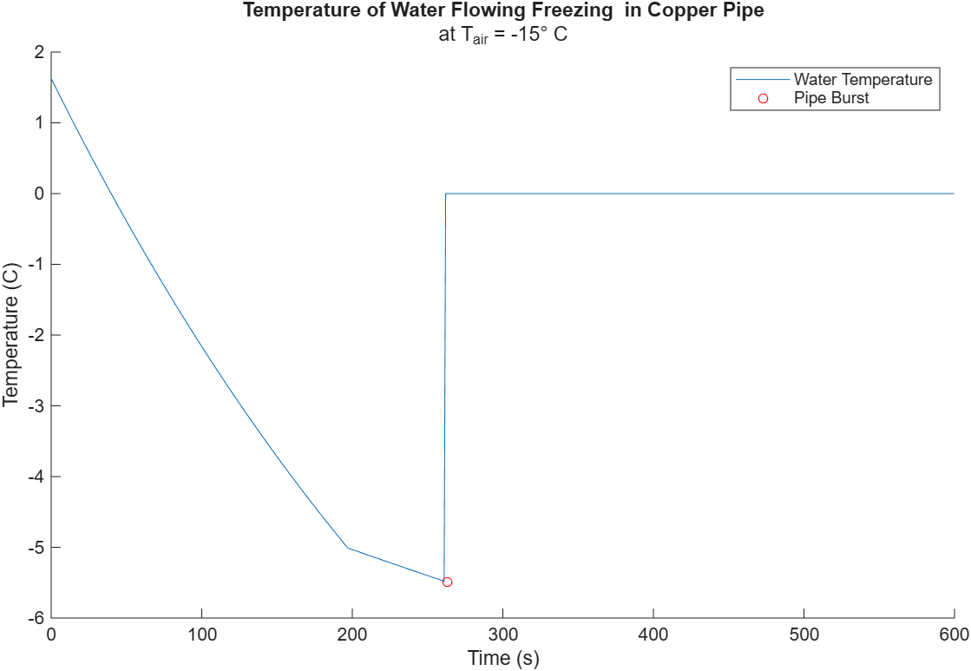
Model
Still water temperature over time in copper tube in –15 C air. Fractures at time = 262 seconds, temperature = -5.0099 C
Water with pump temperature over time in copper tube in –15 C air. Fractures at time = 263 seconds, temperature = -5.4851 C
Notes:
Mira

Slide 7
Comparison
“I’m not shocked that its linear, but I’m bored that it’s linear” Mira
Our physical model system did not freeze
  Partly due to leak in system
  Could have flow rate and material wrong
  Mix of ice cubes and air touching pipe

